Slide 1


Pakistan’s
E-commerce Orders Insights

Slide 2

Introduction
Analyzing trends and patterns in eCommerce orders across Pakistan to provide actionable insights for business decisions
best selling categories
orders frequency in different durations
correlation in between important variables

Slide 3

Data Overveiw
Dataset: The dataset contains detailed information of half a million e-commerce orders in Pakistan from March 2016 to August 2018. It contains item details, shipping method, payment method like credit card, Easy-Paisa, Jazz-Cash, cash-on-delivery, product categories like fashion, mobile, electronics, appliance etc., date of order, SKU, price, quantity, total and customer ID. This is the most detailed dataset about e-commerce in Pakistan that you can find in the Public domain.
Variables: The dataset contains Item ID, Order Status (Completed, Cancelled, Refund), Date of Order, SKU, Price, Quantity, Grand Total, Category, Payment Method and Customer ID.

Slide 4
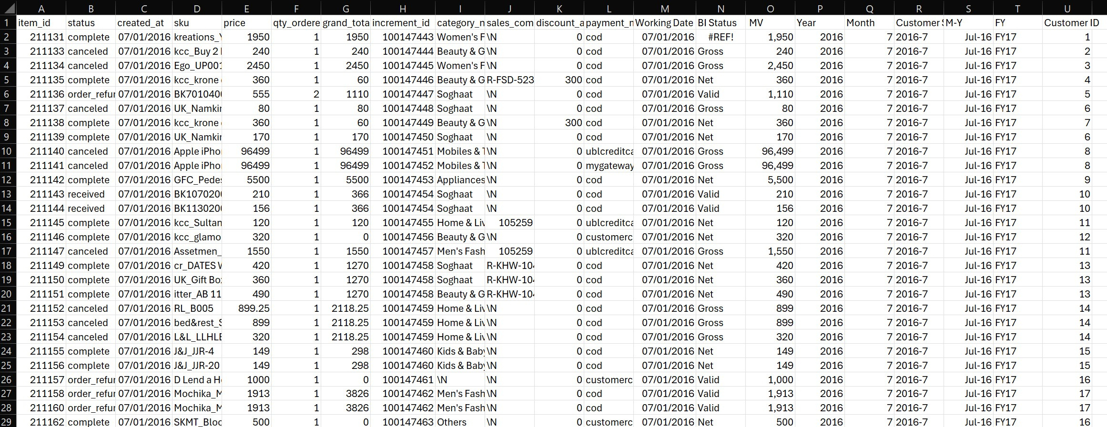

Slide 5
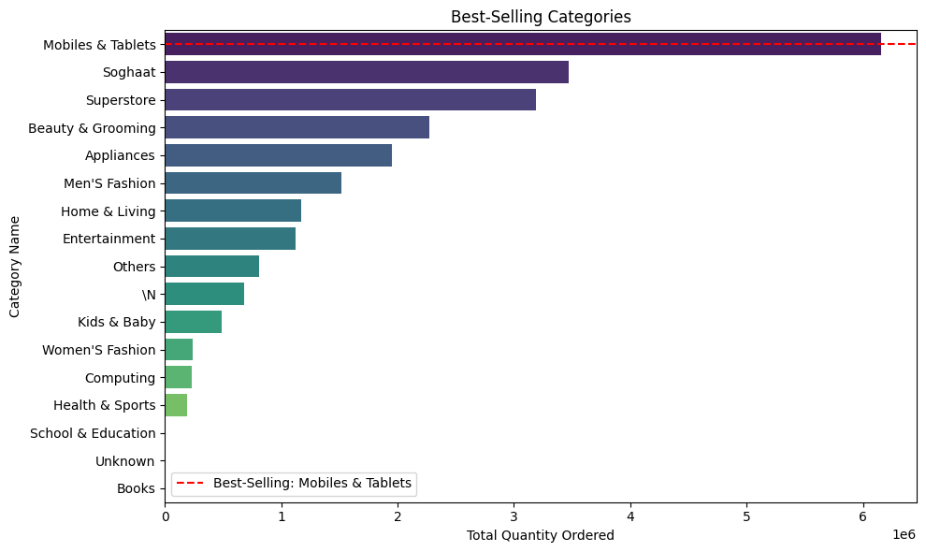
80%
Revenue Growth
Return on Investment
20%
75%
Customer Acquisition Cost
Customer Satisfaction

Slide 6
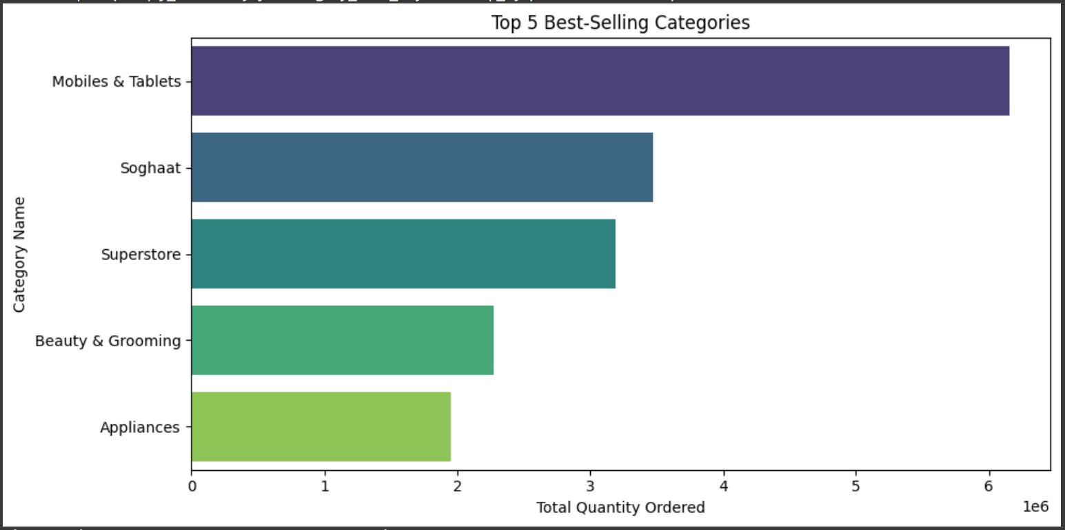

Slide 7
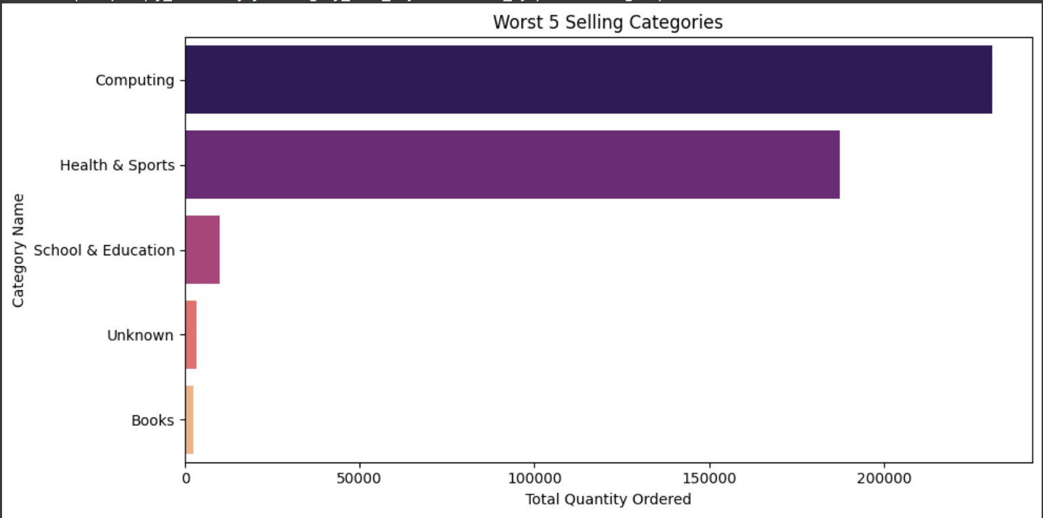

Slide 8
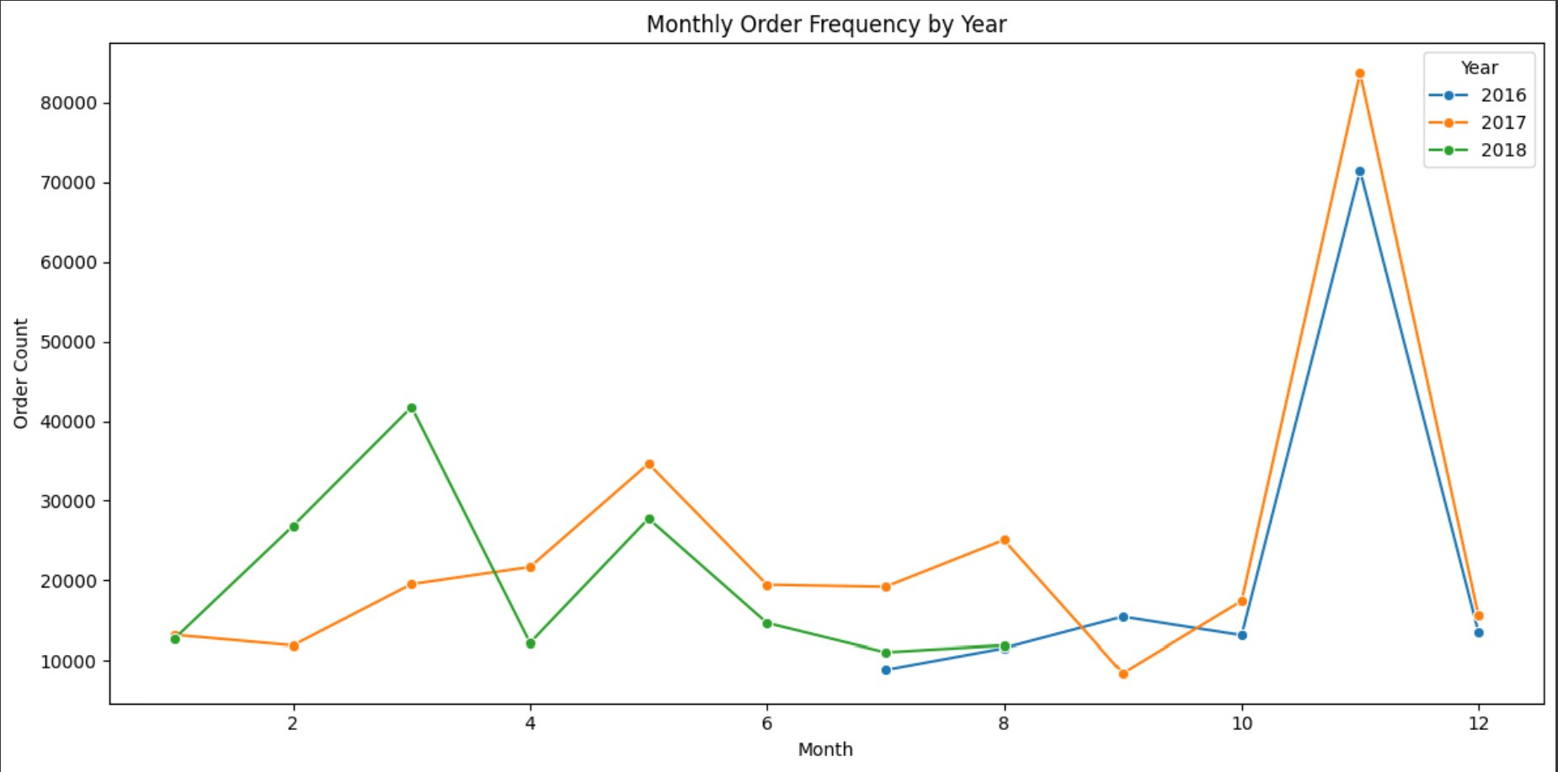

Slide 9
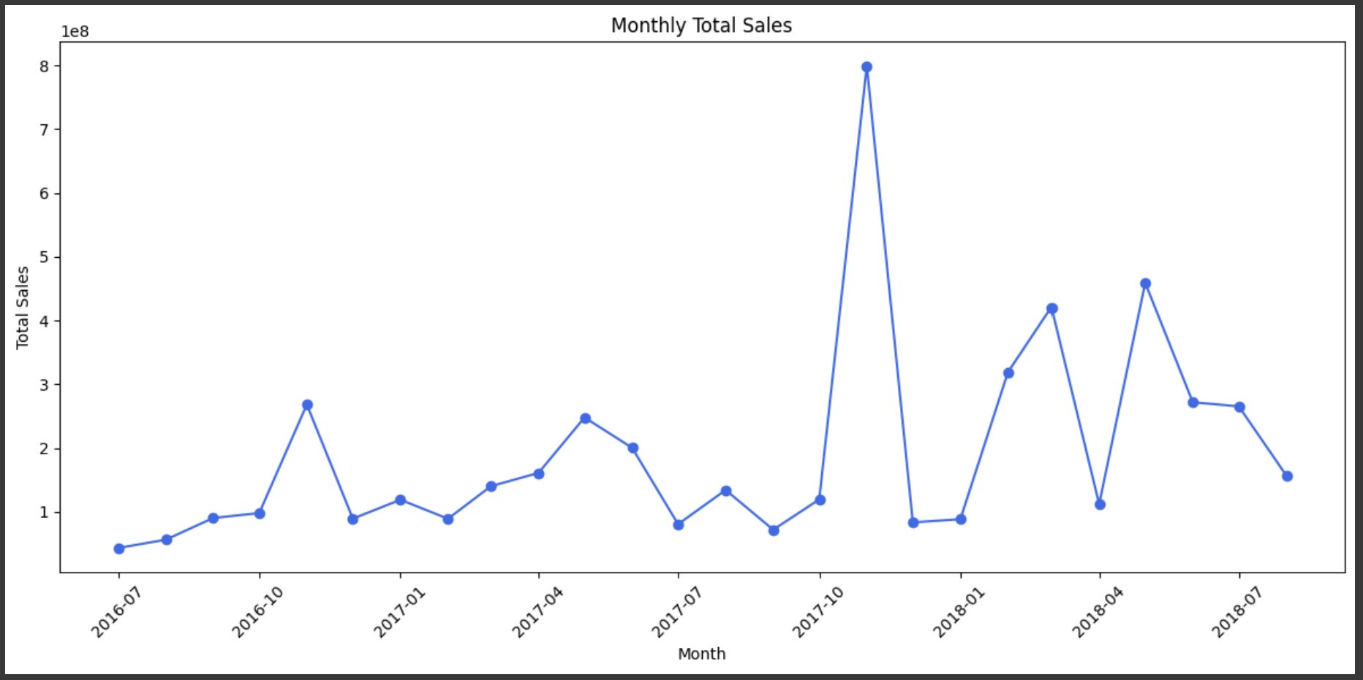

Slide 10
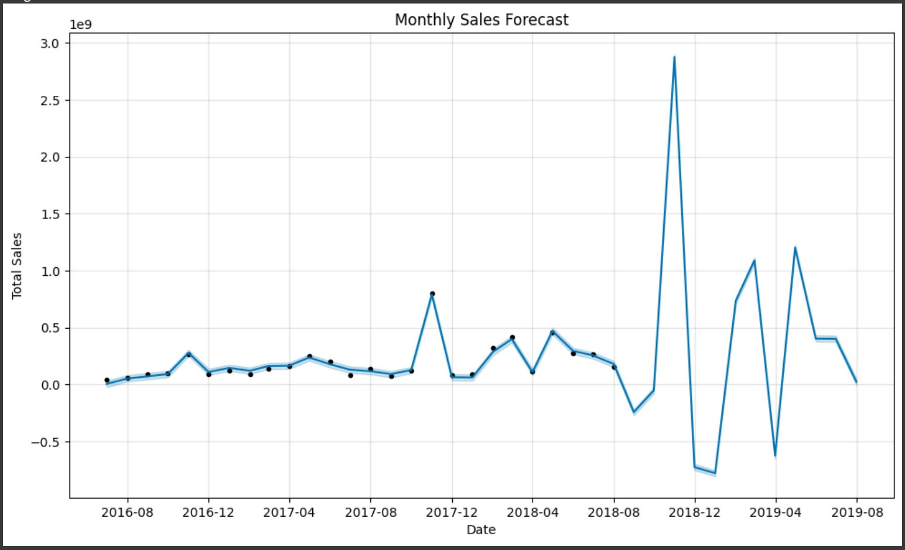

Slide 11
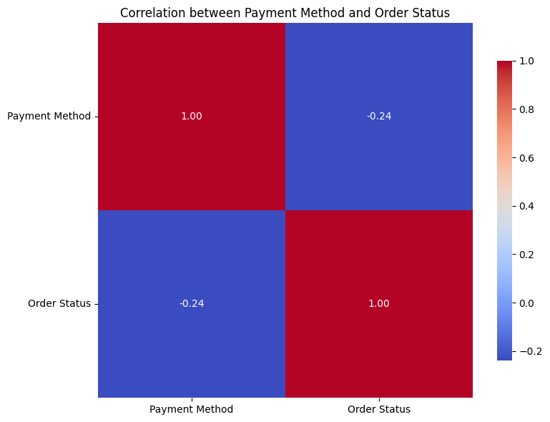

Slide 12
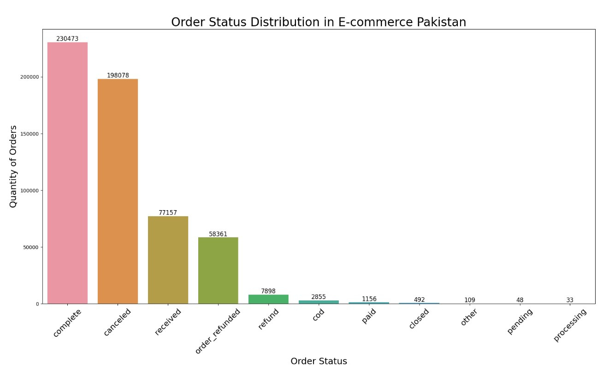

Slide 13
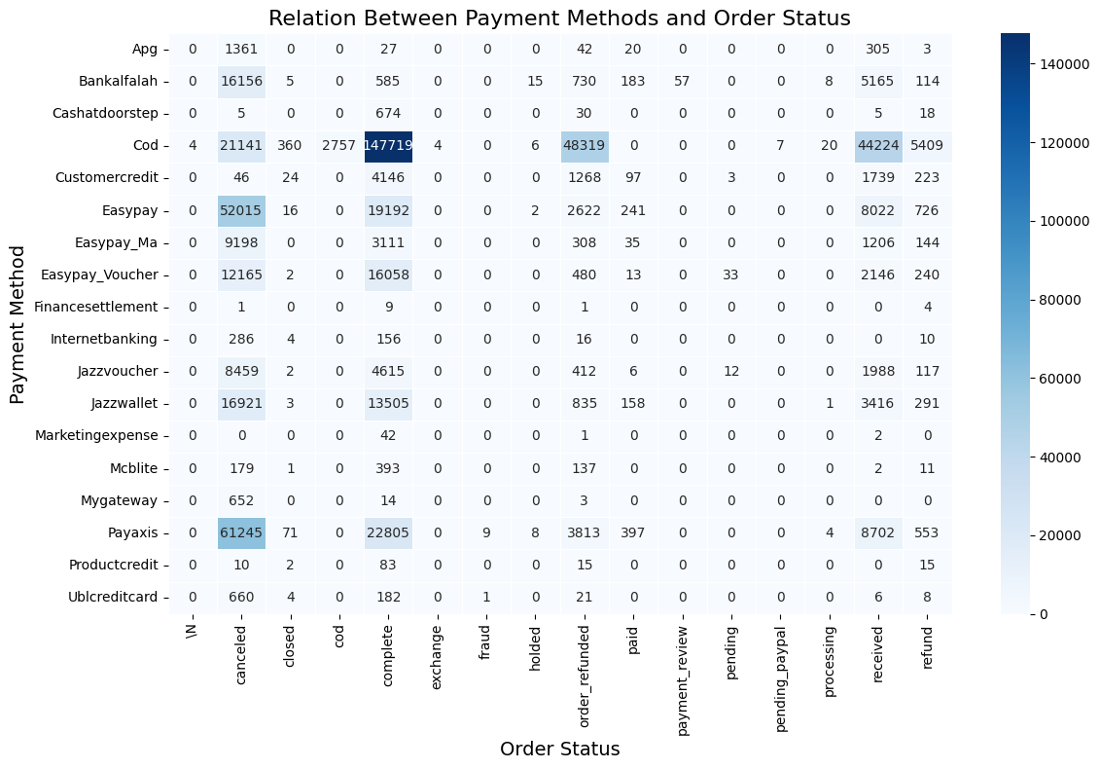

Slide 14
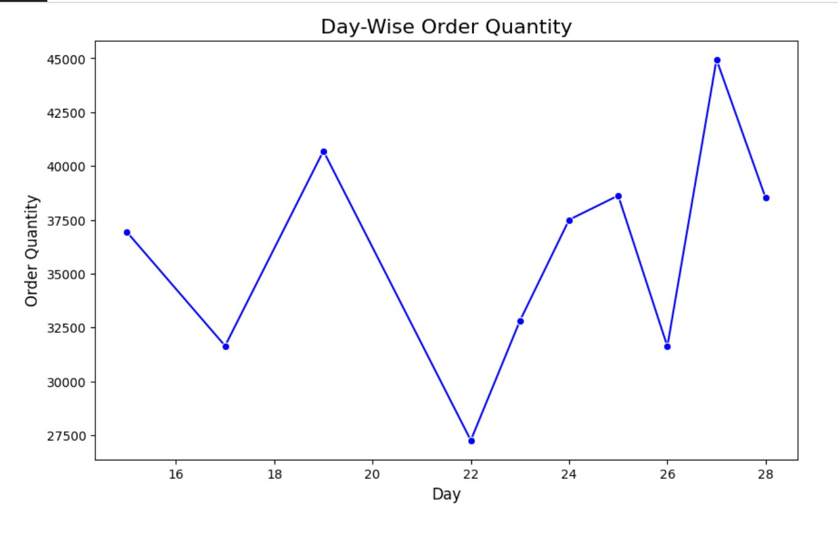

Slide 15
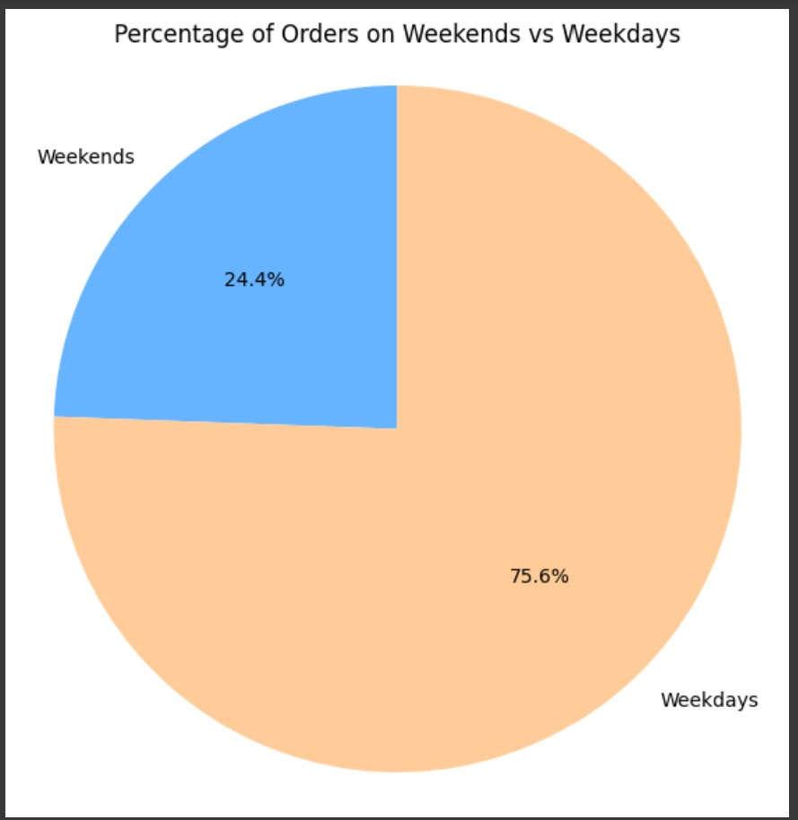

Slide 16
During this EDA exercise, we have achieved several milestones:
We cleaned the dataset by removing null values to ensure accuracy in our analysis.
We renamed the column names for easier comprehension and better organization of the data.
We identified and removed five columns that were completely empty, along with rows that contained nearly half of the empty values, resulting in a refined dataset of 576660 rows and 21 columns.
Our findings include:
The Mobile & Tablets category has the highest order volume, indicating strong consumer demand.
A significant portion of orders, 198,078, were marked as canceled, highlighting areas for improvement in customer satisfaction.
The month of November saw the highest sales, attributed to significant discounts and holiday promotions, providing insights for better marketing strategies.
These insights can guide businesses in making data-driven decisions to enhance their operations and better meet customer needs.

